Slide 1
Strategies for Zone Chairpersons to support GMT and GLT activities
November 12th, 2014
Notes:
Welcome to the Canada-wide GMT/GLT Webinar. I’m PDG Chris Lewis, GMT Coordinator for the Eastern side of Multiple District A. It’s great to have people on the call tonight from coast-to-coast. We have some of our leadership here tonight too – our Constitutional Area Leader, PIP Judge Brian Stevenson, and area leaders PID Terry Graham, PID Gilles Melacon, and PCC Dennis Stevenson. We’re going to learn some ways our Zone Chairpersons can help us achieve the goals of GMT and GLT in our Districts, but most importantly we’re going to hear and share what’s going well in the Districts to strengthen our clubs and our Association.
Before we start, let’s quickly review the controls for GoToWebinar.

Slide 2
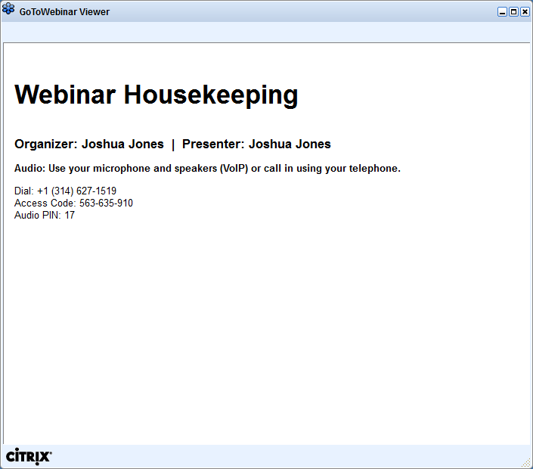
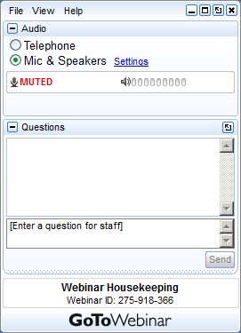
GoToWebinar Interface Review
Notes:
Acquaint your Attendees with what they see on their screen. To the left is the GoToWebinar Viewer through which they see the presentation.
To the right is the GoToWebinar control panel where they can raise their hand, ask questions and select audio mode. Note:
The attendee control panel will collapse automatically when not in use by an Attendee. To keep it open, Attendees can click the “View” menu and uncheck “Auto-hide Control Panel”.

Slide 3
Open and hide your control panel
Join audio:
Choose “Mic & Speakers” to use VoIP
Choose “Telephone” and dial using the information provided
Submit questions and comments via the Questions panel
Note: Today’s presentation is being recorded and will be provided within 48 hours.
Notes:
Give Attendees a closer look at the control panel and how they can participate. Text may be adjusted to suit your event needs.
Note: Hand Raising is enabled (see slide 3)
Visit the “Options” menu in the Organizer control panel a check to allow attendees to Raise Hands.

Slide 4
Please continue to submit your text questions and comments using the Questions Panel
Please raise your hand to be unmuted for verbal questions.
For more information, please contact Tim Holmes, ithelpdesk@a12lions.org
Note: Today’s presentation is being recorded and will be provided within 48 hours.
Notes:
Remind Attendees how to ask questions and provide “more info” or support contact. Text may be adjusted to suit your event needs. Note: Hand Raising is enabled (see slide 4)
Visit the “Options” menu in the Organizer control panel a check to allow attendees to Raise Hands.

Slide 5
Agenda
Update on Canadian Membership – CA II GMT Leader PIP Judge Brian Stevenson
Roles and Responsibilities – MDA GLT Coordinator (East) PCC Tom Gordon
Baseline Review – GMT Area Leader (MDA – MDN) PID Terry Graham
Review of District Best Practices – MDA GMT Coordinator (East) IPDG Chris Lewis
Wrap-Up and Next Steps – GMT Area Leader (MDA – MDN) PID Terry Graham

Slide 6
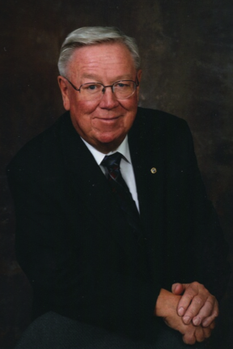
Update on Canadian Membership
Constitutional Area II Global Membership Team Leader PIP Judge Brian Stevenson

Slide 7
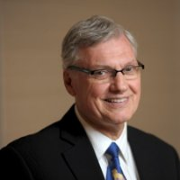
Role of the Zone Chairperson
Multiple District A (East) Global Leadership Team Coordinator PCC Tom Gordon

Slide 8
POSITION OF THE ZONE CHAIR
The Zone Chairperson is the link between the clubs in zone and the District Leadership team
Multiple District
District
Zone
Club
Lion

Slide 9
THE DUTIES OF THE ZONE CHAIR
Further the Purposes of the Association
New Clubs, CEP, CGL
Serve as liaison to the District, Zone and Club
Promote District and International programmes – IP’s Theme, R.A.P., etc
Visit the Clubs in the Zone and report and monitor the Clubs’ wellbeing
One ‘Official club visit – report sent to the Governor’s Team
One unofficial visit during a club activity
Continued…

Slide 10
Duties of the Zone Chair (Continued)
Attend District Cabinet meetings as a voting member
Attend the District Convention
Chair Governor’s Zone and Joint Zone Advisory meetings
Work with the GMT and GLT to recruit and develop members
Perform other duties assigned by the District Governor and/or Cabinet

Slide 11
SKILLS OF A ZONE CHAIR
Reporting and sharing of information
Use technology - PowerPoint
Communicate
Problem solve
Conflict management
Time management
Motivator, coach and model

Slide 12
TOOLS
Zone Chair training on-line, webinars
Zone Chair training workshop
Zone Chairperson Manual
Lions Learning Centre- on-line leadership courses
District mentors

Slide 13
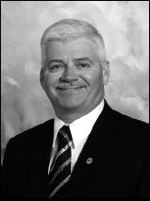
Baseline Review
Global Membership Area Leader (Eastern Canada – MDA/MDN) PID Terry Graham

Slide 17
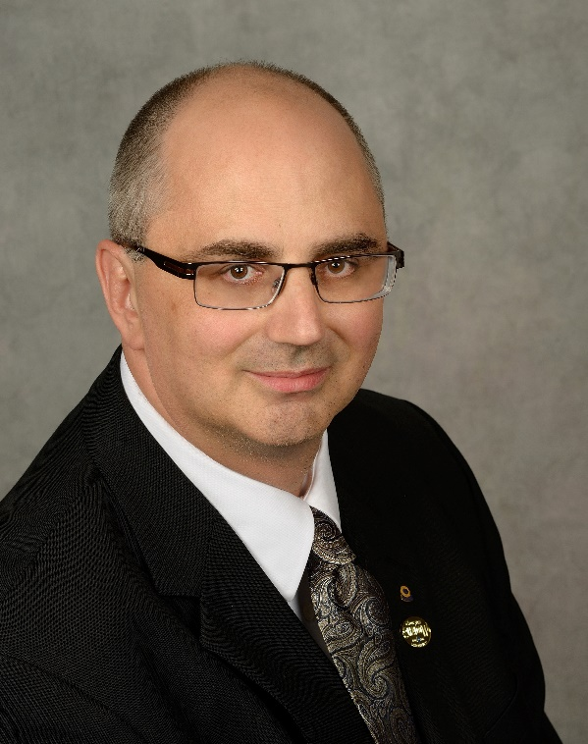
District Best Practices Review
Multiple District A (East) Global Membership Team Coordinator IPDG Chris Lewis

Slide 18
Wrap-Up and Next Steps

